Slide 1
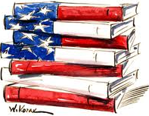
(Beginnings – 1783)
Exploration and Early Colonization of America
The English in America
The French and Indian War (1754-63)
The Road to Revolution(1763-1775)
The American Revolution (1775-1783)
The Constitution

Slide 2
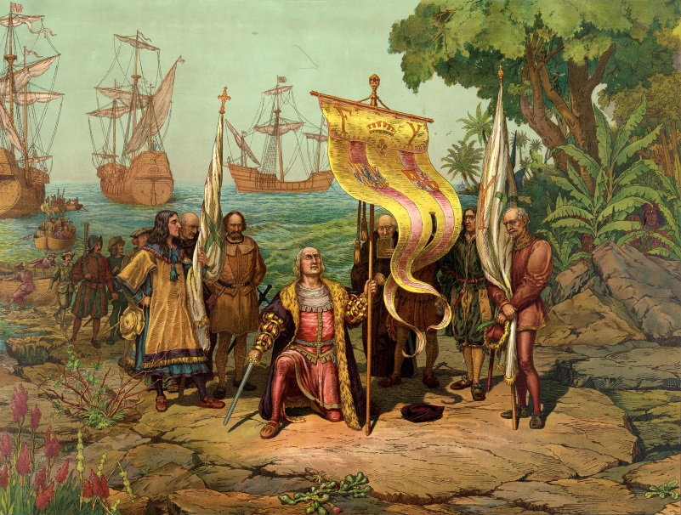
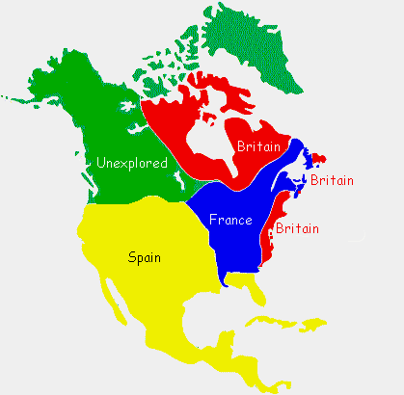
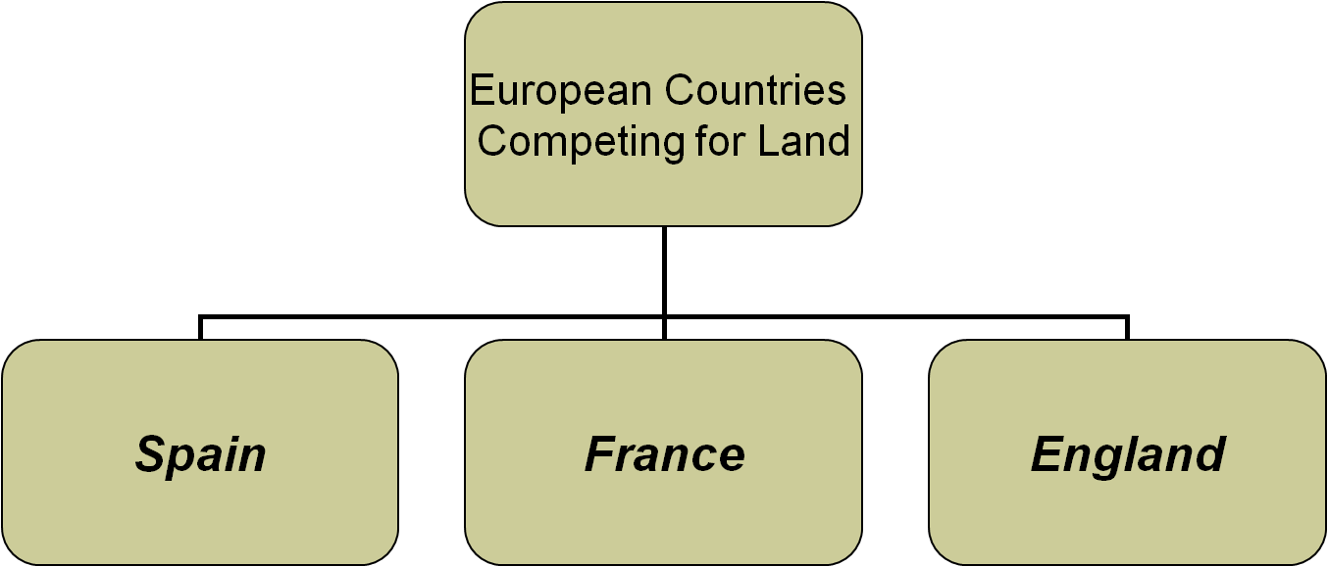
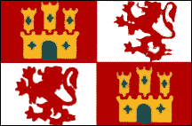
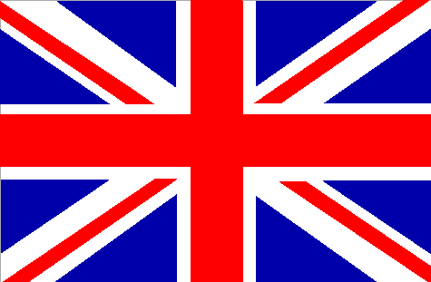
EXPLORATION & EARLY COLONIZATION OF AMERICA
Columbus sailed to the New World in 1492. He claimed the Americas for Spain. This set off a race to the New World.
Spain controlled the southwestern portion of North America and most of South America.
The Spanish ruled by conquering the natives and became wealthy off resources such as gold.
France controlled the interior portion of North America.
The French ruled by building relationships with the natives and becoming trading partners. They became wealthy from traded goods such as furs.
England controlled the eastern coast of North America and part of the far north.
The English came to America for economic reasons (money) and social reasons (religion).
Wealth first came from cash crops like tobacco.

Slide 3
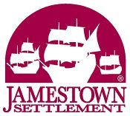
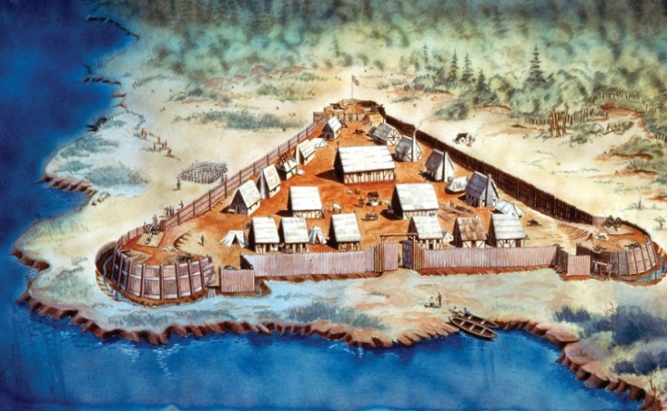
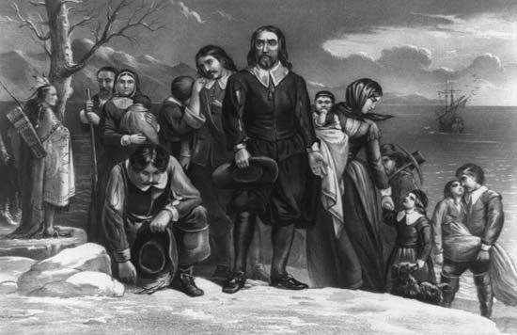
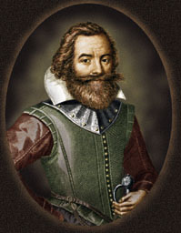
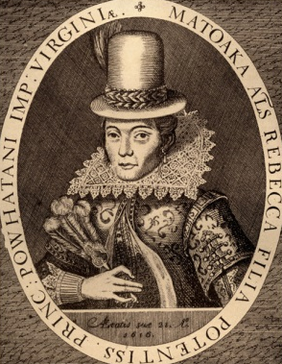
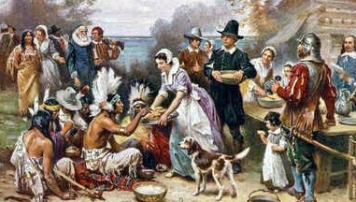
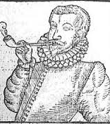
THE ENGLISH IN AMERICA
Settlement at Jamestown
Pilgrims landing at Plymouth
The first successful English settlement in the new world began in 1607. Jamestown was started by the Virginia Company of London in hopes of making a profit from gold.
The start was a rough one. The outpost suffered from starvation and disease during the Starving Time.
Through tough leadership of John Smith, and help from friendly Indians like Pocahontas, the settlement survived. It became profitable after John Rolfe began growing the cash crop of tobacco.
The success in Virginia was followed up in the area that would become Massachusetts. In 1620, a group of Pilgrims founded Plymouth as a place to worship their religion.
The first winter was rough and many died. They made friends with the natives such as Squanto and Samoset. They helped the settlers adapt to the environment.
As a symbol of the relationship between the English and the natives, a celebration was held. This became the first Thanksgiving.
First Thanksgiving
John Smith
Pocahontas

Slide 4
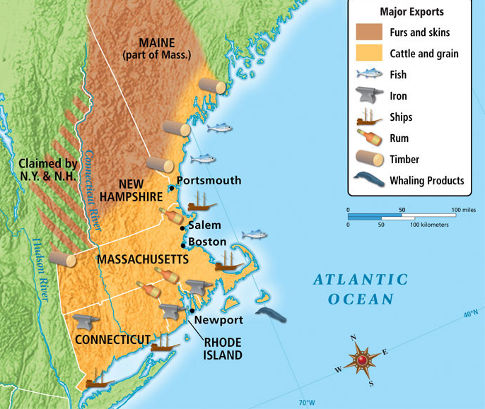
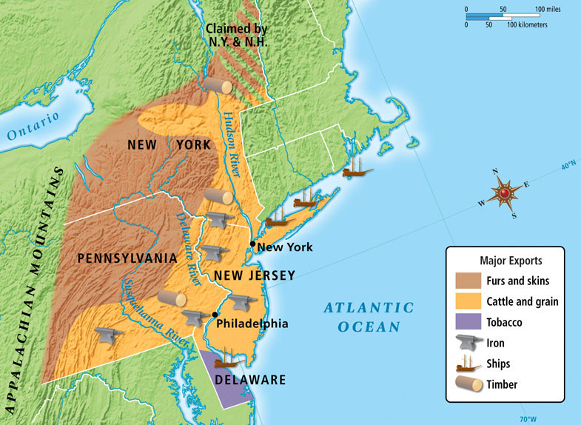
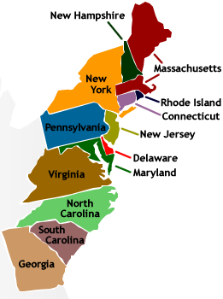
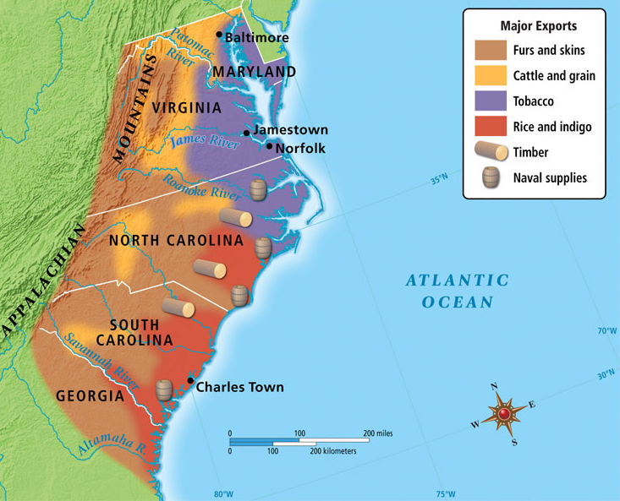
THE ENGLISH IN AMERICA
THE 13 COLONIES
The New England Colonies were Massachusetts, Connecticut, Rhode Island, and New Hampshire. They all began as Puritan colonies. The geography is hilly and rocky. The soil is poor and only supports subsistence farming. The cold winters make for a very short growing season. As a result, the economy consisted of fishing, whaling, shipping, timber, furs, and livestock.
New England Colonies
The Middle Colonies were New York, Pennsylvania, New Jersey, and Delaware. Most were proprietary colonies with one or more owner. The geography is mostly rolling plains and forests. The soil is fertile and allows for cash crops of grain (Bread Basket Colonies). The mild summers and short winters allow for a substantial growing season. The people and economy of the middles colonies are diverse. People of all nationalities and religions were welcome. The economy consisted of livestock, grain, fishing, furs, shipping, and iron.
Middle Colonies
Southern Colonies
The Southern Colonies were Maryland, Virginia, North Carolina, South Carolina, and Georgia. Most began as royal colonies. The geography is flat, coastal plains with wide rivers. The warm summers and short winters provide a nearly year round growing season. The economy revolves around the plantation system – cash crops grown with slave labor. The major cash crops were tobacco, rice, and indigo.

Slide 5
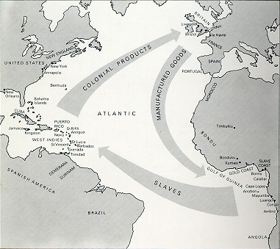
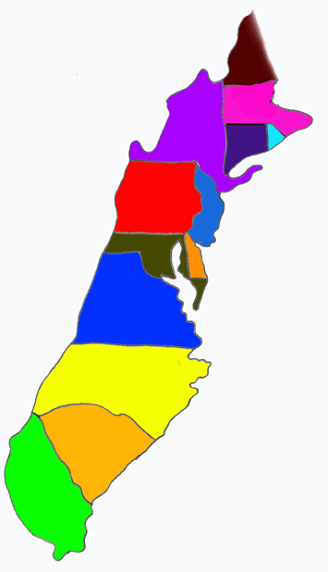
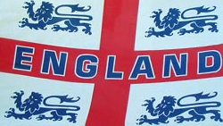
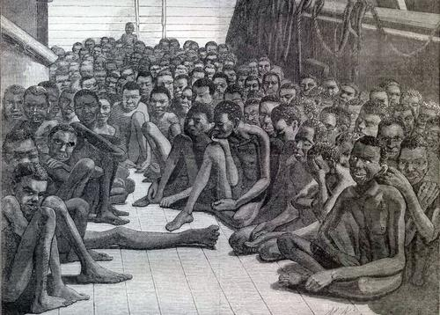
THE ENGLISH IN AMERICA
THE 13 COLONIES
ECONOMIC ACTIVITY
MERCANTILISM
TRIANGULAR TRADE
System of trade between the colonies, Europe or Africa, and the West Indies.
Colonies sent natural resources back to the parent country (timber, crops, furs, iron, etc.)
The Middle Passage was the leg of the triangular trade that saw the importation of slaves to America.
The parent country would sell manufactured goods back to the colonies to make a profit.
The parent country always benefitted the most from this system. They even passed laws to force colonists to trade only with them.

Slide 6
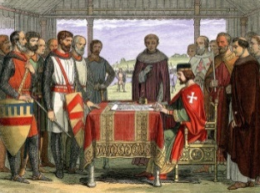
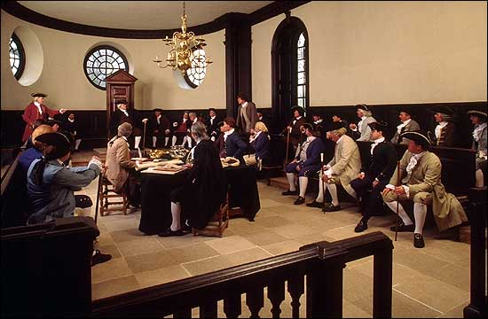
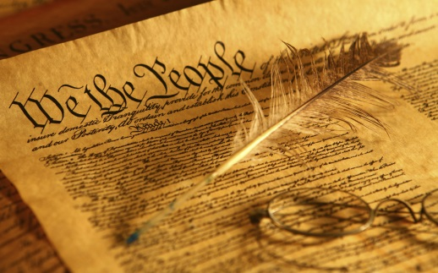
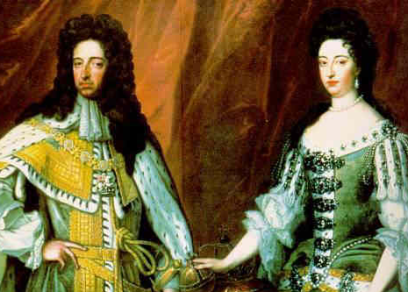
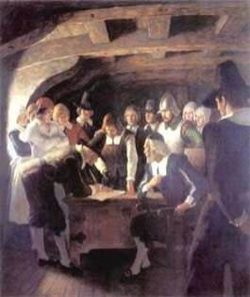
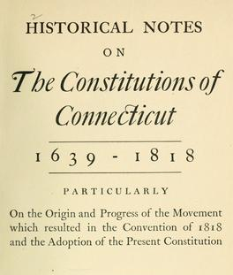
THE ENGLISH IN AMERICA
REPRESENTATIVE GOVERNMENT BEGINS
Magna Carta
This “Great Charter” was signed by King John of England in 1215. This document limited the power of the king and protected the rights of some of his subjects (only the nobles).
House of Burgesses
This Virginia group began in 1619 was the first elected representative body in America.
It would later inspire our House of Representatives.
English Bill of Rights
In 1689, William & Mary, the rulers of England agreed to the English Bill of Rights. This greatly limited the power of the monarchy and protected the rights of all English people.
Mayflower Compact
Signed in 1620 aboard the Mayflower.
This was an agreement among the Plymouth settlers for self government for the good of the colony. They would use town hall meetings and majority rule to decide.
Representative Government (self-government)
Fundamental Orders of Connecticut
Created in 1639, this was the first written constitution in America. It provided a detailed plan of government in which power rested with the people.

Slide 7
EXPLORATION & COLONIZATION
IMPORTANT PEOPLE AND TERMS
Three Gs – God, Gold, Glory refer to the economic, social, and political reasons for exploration.
1607 – founding of Jamestown
1620 – Mayflower Compact written
Jamestown – first successful English settlement in the New World
Cash crop – crops grown specifically to be sold for profit.
Subsistence farming – Growing just enough to support a family with little left to be sold for profit.
Breadbasket Colonies – nickname given to the middle colonies because of the large amount of grain grown there.
Plantation – large farms growing cash crops, usually with the use of slave labor.
Mercantilism – economic system where a parent country profits from the natural resources of a colony.
Triangular Trade - System of trade between the colonies, Europe or Africa, and the West Indies
Middle Passage - the leg of the triangular trade that saw the importation of slaves to America.
Fundamental Orders of Connecticut – 1639, the first written constitution in America
Columbus – explorer credited with discovering the Americas
John Smith – early leader of Jamestown.
John Rolfe – Jamestown settler who began growing cash crop of tobacco.
Pocahontas – Native American who assisted Jamestown’s settlers
Pilgrims – English settlers who traveled to Massachusetts to escape religious persecution.
Squanto – Native American who helped the Pilgrim settlers of Plymouth
Puritans – religious group and founders of New England Colonies.
Quakers – very tolerant religious group found in the middle colonies.
William Penn –founder of Pennsylvania (Quaker Colony)
James Oglethorpe – founder of Georgia (debtor colony, buffer to Spanish Florida)
Lord Baltimore – founder of Maryland (haven for Catholics))
House of Burgesses – 1619, first elected representative body in America.
Magna Carta - “Great Charter”, 1215. This document limited the power of the king
Mayflower Compact – 1620, an agreement for self government and majority rule.

Slide 8
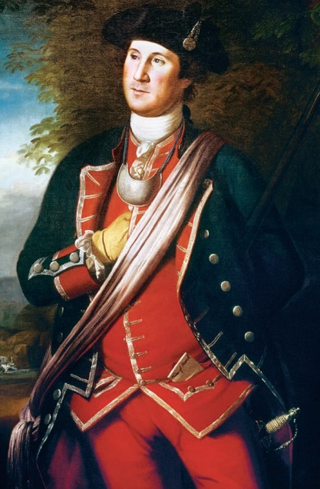
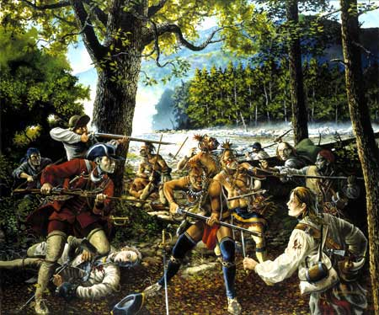
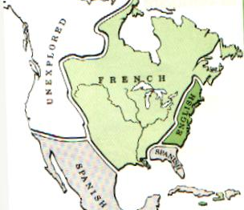
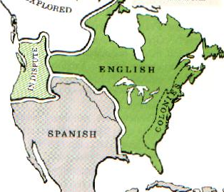
THE FRENCH & INDIAN WAR (1754-1763)
WAR!!!
A young Colonial officer proves himself a hero for the British during the war. Later he would lead American troops against the British during the Revolution. His name was George Washington.
The two countries were fighting over the Ohio River Valley. This area was highly sought after for the forests, the soil, and mainly a rich fur trade.
This was a conflict between the French (with their Indian allies) and the British (aided by the colonists). It was part of a larger war being fought all over the world. Colonists would learn many lessons about warfare during their role in this conflict.
North America – Before the War
North America – After the War
TREATY OF PARIS, 1763
After years of fighting around the world, France finally surrenders to Great Britain.
This had a great effect on the colonies. France gave up all it’s land claims in North America. The British Colonies expanded all the way to the Mississippi River. Colonists were eager to begin moving west.
The Spanish Empire grew as well. Spain now claimed most of the land west of the Mississippi River.

Slide 9
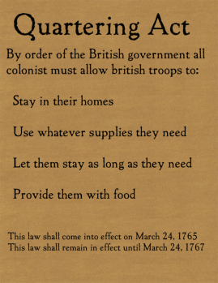
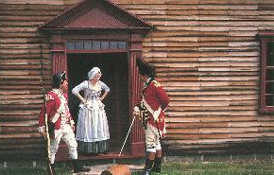
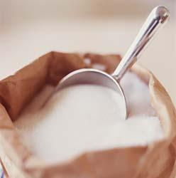
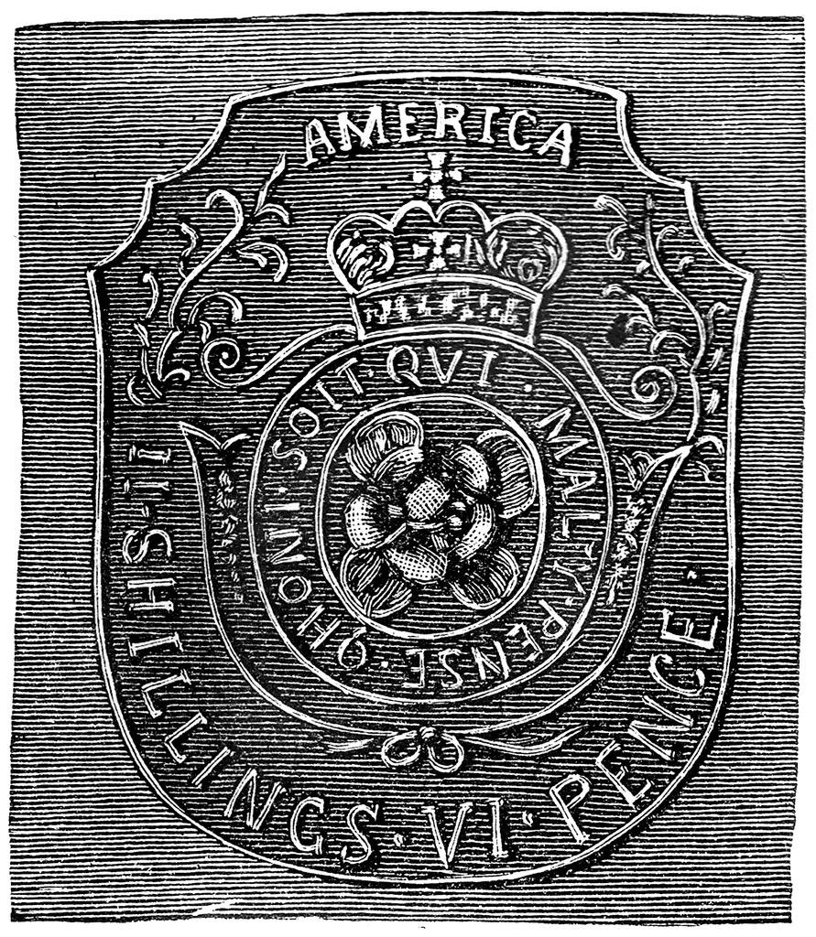
THE ROAD TO REVOLUTION
Quartering Act - 1765
Law passed by Parliament that required colonists to house and supply British soldiers. Although most colonists obeyed, many were outraged at the law.
STOP
The Proclamation of 1763
Order by Parliament that forbade colonists from settling west of the Appalachian Mountains. Britain was in debt and could not afford another war with the Indians in the Ohio River Valley.
Stamp Act - 1765
This was a tax on paper goods and legal documents. These items had to be imprinted with a stamp to show the tax had been paid. Colonists organized groups like the Sons of Liberty who boycotted, and also held the Stamp Act Congress to show their disapproval of this tax.
Sugar Act - 1764
This was a tax on imported sugar and molasses. The rise in price increased smuggling of these items.

Slide 10
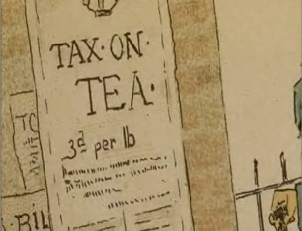
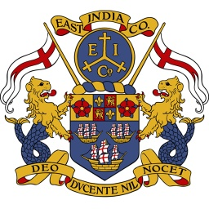
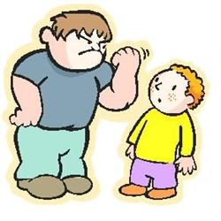
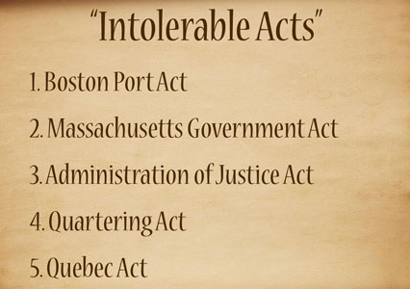
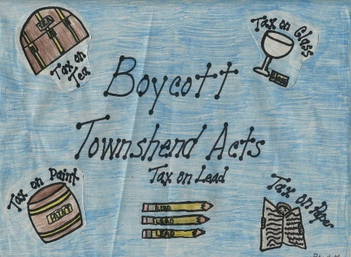
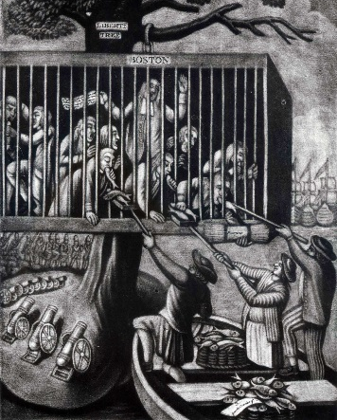
THE ROAD TO REVOLUTION
The Declaratory Act 1766
Order by Parliament that gave Great Britain complete control over the colonies. Basically giving themselves the power to make any law or tax they wanted.
The Tea Act 1773
Tax place on tea. The law also gave Britain (through the East India Company) a monopoly on the tea trade. Actually reduced the price of tea. Colonist still protested because they had not had a say in the law.
The Townshend Acts 1767
Series of indirect taxes on products such as paper, lead, paint, glass and tea.
Also gave British officers writs of assistance (a type of search warrant) to crack down on smuggling.
The Intolerable Acts 1774
Series of laws meant to punish Massachusetts for the Boston Tea Party. Closed the port of Boston and put Boston under military rule. Meant to be an example to all other colonies.

Slide 11
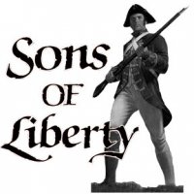
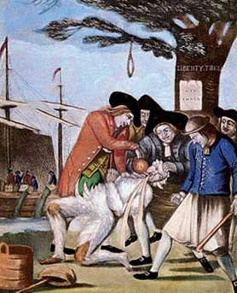
THE ROAD TO REVOLUTION
COLONIAL ACTIONS
The Sons of Liberty were colonial protest groups. The most vocal was the Boston Sons of Liberty which was started by Samuel Adams.
A boycott is a refusal to buy goods as a form of protest. The colonial boycott on paper, tea and other taxed items proved to be very effective.
The Sons of Liberty sometimes used methods of protest that were intimidating or violent. They would harass tax collectors and loyalists. Sometimes they would assault them. They also like to use “tar and feathering”. When this happened the target was coated with tar and then covered in feathers.

Slide 12
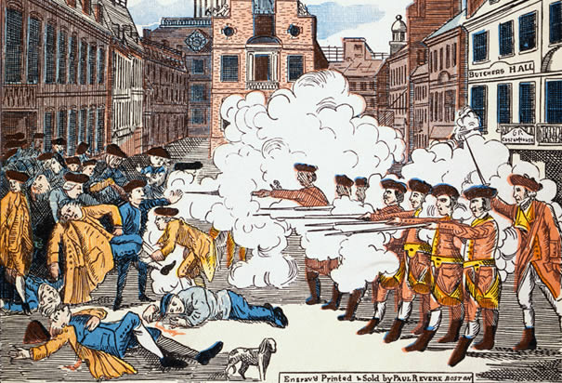
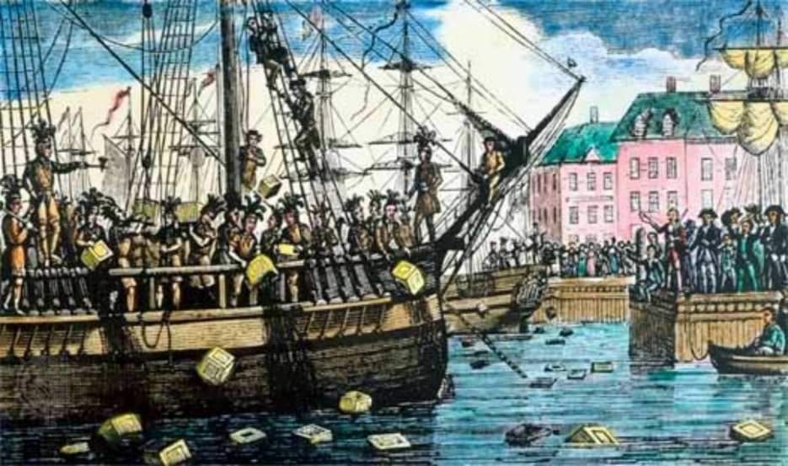
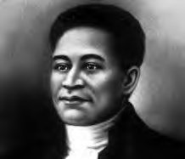
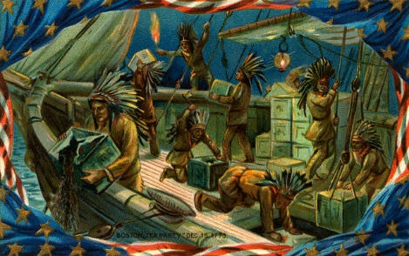
THE ROAD TO REVOLUTION
COLONIAL ACTIONS
Boston Massacre – This event took place in March 1770. A mob of Bostonians protesting the Townshend Acts were fired upon by British soldiers. The event was more of a confusing mistake but it was called a massacre by the Sons of Liberty to build resentment against the British.
Boston Tea Party – A group of colonists, in protest of the Tea Act, boarded British vessels and dumped their cargo of tea overboard. The act angered Britain and resulted in the Coercive Acts. A series of laws designed to punish Massachusetts for destroying the tea. The laws were so harsh, colonists called them the Intolerable Acts.
Paul Revere – a member of the Sons of Liberty. He created the above picture of the Boston Massacre as a form of propaganda.
Crispus Attucks– first African American to die for American independence. He was one of the 5 killed at the Boston Massacre.

Slide 13
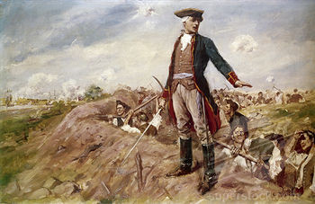
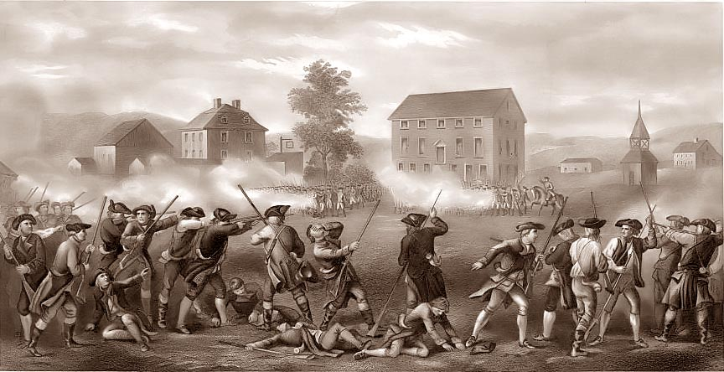
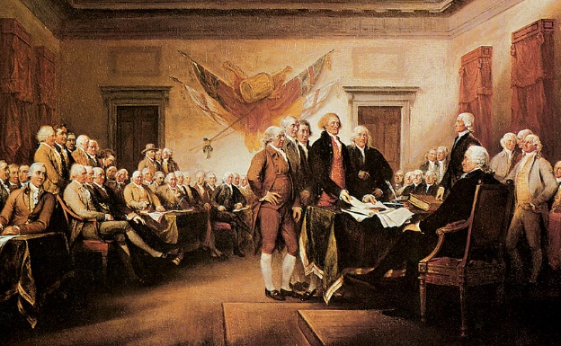
THE ROAD TO REVOLUTION
COLONIAL ACTIONS
Lexington and Concord
“The Shot Heard ‘Round the World” – the first shots of the war were fired here. Colonial Minutemen chased British redcoats all the way back to Boston. The event becomes the first battle of the Revolution.
Battle of Bunker Hill
First major battle of the war. Even though the British were victorious, it showed the British that the war would not be easily won. It also demonstrated a disadvantage the Americans would face throughout the war – lack of supplies.
“Common Sense”
Thomas Paine wrote a pamphlet titled “Common Sense” in order to persuade Americans to support a break from Great Britain.
2nd Continental Congress
Delegates met in Philadelphia to discuss recent events. They drafted the Olive Branch Petition to seek peace. They also selected George Washington to create and lead the Continental Army. They also drafted a Declaration of Independence authored mainly by Thomas Jefferson.

Slide 14
THE ROAD TO REVOLUTION
DECLARATION OF INDEPENDENCE
The Preamble to the Declaration basically explains that the colonists believe it is time for a break from Great Britain. This document will explain why they have the right to do so.
Next, the Declaration explains their belef on the rights of man. Key to this is the idea that government exists to protect people. When a government stops protecting, the people have the right to a new government.
Although Thomas Jefferson is given credit for being the author of the Declaration, it was really the product of a committee made up of Jefferson, Adams, Franklin, Livingston, & Sherman.
The document ends by stating America is a free and independent nation. It is notice to the world of our intentions and also a plea for help.
Next, is a long list of violations the colonists claim against Britain. Taxation without representation, halting their trade, quartering troops, are among the list of 27 charges.
The Declaration of Independence was just a statement. It would mean absolutely nothing without winning the war to follow. Each man who signed it would be considered a traitor to Britain and would be hanged for treason if caught.
Then the document spells out what the colonists have tried to do before coming to the decision to break from Britain. They list warning and petitioning. It does not list out some of the more violent reactions of colonists (tarring and feathering, etc.).

Slide 15
THE AMERICAN REVOLUTION
EVENTS
Battle of Lexington & Concord is the first battle of the Revolution.
The Declaration of Independence is approved by the 2nd Continental Congress.
The Battle of Saratoga is the turning point of the war. This victory convinces France to support the American cause.
The Battle of Yorktown was the last major battle of the war. Washington and the French Navy surrounded Cornwallis and forced his surrender.
1775
1776
1777
1781
1783
Battle of Bunker Hill is the first major battle and shows the determination of the Americans.
Battle of Trenton is a victory over the Hessian mercenaries. This victory gives new hope to the Americans as well as needed supplies.
The winter at Valley Forge, PA becomes a symbol of the sacrifice Americans were willing to make. Received training to make them a real army.
The Treaty of Paris 1783 officially ended the revolution. Britain recognized American independence and the US boundaries were set.

Slide 16
THE AMERICAN REVOLUTION
ADVANTAGES / DISADVANTAGES
American Advantages
They were able to fight on their own ground which helped them to know the areas.
They had a widespread acquaintance with firearms.
They had better or superior rifles with more range and accuracy than the British.
They had experience from the French and Indian War which helped to know what they were coming into and what mistakes they made last time.
British Advantages
They were well trained, equipped, and had exact orders in which they followed very closely.
They had the best navy which protected the coastlines and supply lines.
They had co - operation Loyalists and Indians to help them fight.
They had enough money to hire foreign troops from Germany also known as Hessians.
American Disadvantages
Their army lacked training and discipline.
Many men deserted the army because they just didn't want to fight anymore they would flee to their homes.
Shortages of ammo, food, clothing, and medicine also made men flee and people die of starvation or weather.
They lacked a real navy which hurt them because they had no way to defend the coastlines if they didn't have a real navy.
British - Disadvantages
They were a long distance from home.
They never adapted their fighting style which hurt them.
They believed they could just run Americans over without any problem, this underestimation caused them to be unprepared and lose many men in some cases.
They used smoothbore muskets which took longer to load than the American guns so by the time they could get their gun loaded they would be shot.

Slide 17
THE AMERICAN REVOLUTION
IMPORTANT PEOPLE
Thomas Paine – patriot author of “Common Sense” who argued for a split with Britain.
George Washington – commanding general of the Continental Army
King George III – monarch (king) of Britain during the American Revolution.
Marquis de Lafayette – French nobleman who volunteered to lead and train American troops.
Lord Cornwallis – British General who surrendered at Yorktown basically ending the war.
John Paul Jones – American Naval Commander during the Revolution.
Benedict Arnold – American officer who betrayed his country and joined Britain during the war.
Benjamin Franklin – American statesman who convinced France to ally with the United States.

Slide 18
THE AMERICAN REVOLUTION
THE END AND BEYOND
Treaty of Paris 1783
The Articles of Confederation – Our first Government
Strong States
During the war, the Continental Congress created the Articles of Confederation. This was the first “constitution” to govern the United States.
It was a loose union of states. Most powers were found at the state level. For example, the federal government could not tax, draft soldiers, or settle state disputes. These provisions were a direct result of our founders fear of a strong central government.
This will cause problems after the war and will eventually be replaced by the Constitution.
In the treaty:
1)Britain recognized American Independence.
2)The boundaries were set for the new nation.
3)Both sides agreed to pay debts
4)America gained fishing rights off Canada
5)Both sides agreed to release prisoners.

Slide 19
THE AMERICAN REVOLUTION
IMPORTANT PEOPLE AND TERMS
French and Indian War – war between Britain and France for control of the Ohio River Valley.
Quartering Act – Law passed by Parliament that required colonists to house and supply British soldiers.
The Proclamation of 1763 - Order by Parliament that forbade colonists from settling west of the Appalachian Mountains.
Stamp Act - This was a tax on paper goods and legal documents.
Sugar Act - This was a tax on imported sugar and molasses.
The Tea Act - Tax place on tea. The law also gave Britain a monopoly on the tea trade.
The Townshend Acts - Series of indirect taxes on products such as paper, lead, paint, glass and tea.
writs of assistance - a type of search warrant
The Intolerable Acts - Series of laws meant to punish Massachusetts for the Boston Tea Party. Closed the port of Boston and put Boston under military rule. Meant to be an example to all other colonies.
Sons of Liberty - colonial protest groups
boycott - a refusal to buy goods as a form of protest
Boston Massacre –A mob of Bostonians protesting the Townshend Acts were fired upon by British soldiers. The event was called a massacre to build resentment against the British
Boston Tea Party – A group of colonists, in protest of the Tea Act, boarded British vessels and dumped their cargo of tea overboard.
Minutemen – colonial militia men who could be ready to fight at a moment’s notice.
Crispus Attucks – first African American to die for American independence
Thomas Paine - a pamphlet titled “Common Sense” in order to persuade Americans to support a break from Great Britain.
George Washington – commanding general of the Continental Army
Marquis de Lafayette – French nobleman who volunteered to lead American troops.
John Paul Jones – American Naval Commander during the Revolution.
Lord Cornwallis – British General who surrendered at Yorktown ending the war.
Benjamin Franklin – American who convinced France to ally with the United States.
King George III – monarch (king) of Britain during the American Revolution.
Benedict Arnold – officer who betrayed his country and joined Britain during the war.
Battle of Lexington & Concord - the first battle of the Revolution.
The Battle of Saratoga - the turning point of the war. This victory convinces France to support the American cause.
Battle of Yorktown - the last major battle of the war.
Valley Forge, PA becomes a symbol of the sacrifice Americans were willing to make. Received training to make them a real army.
Treaty of Paris 1783 - officially ended the revolution
Articles of Confederation - the first “constitution” to govern the United States written during the war.

